Slide 1
Process MANAGEMENT

Slide 2
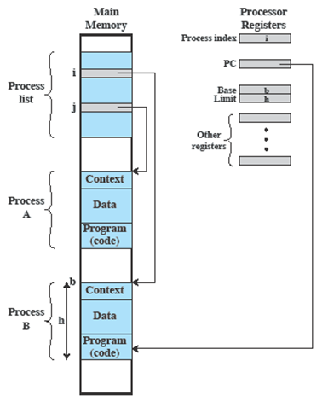
Process Management
The entire state of the process at any instant is contained in its context
New features can be designed and incorporated into the OS by expanding the context to include any new information needed to support the feature

Slide 3
Process Concept
An operating system executes a variety of programs:
Batch system – jobs
Time-shared systems – user programs or tasks
Process – a program in execution;
Process execution must progress in sequential fashion
Multiple parts
The program code, also called text section
Current activity including program counter, processor registers
Stack containing temporary data
Function parameters, return addresses, local variables
Data section containing global variables
Heap containing memory dynamically allocated during run time

Slide 4
Process Concept
Program is passive entity stored on disk (executable file)
Process is active entity
Program becomes process when executable file loaded into memory
Execution of program starts via GUI mouse clicks, command line entry of its name, etc.
One program can have several processes
Processes that stay in background to handle some activity are called daemons

Slide 5
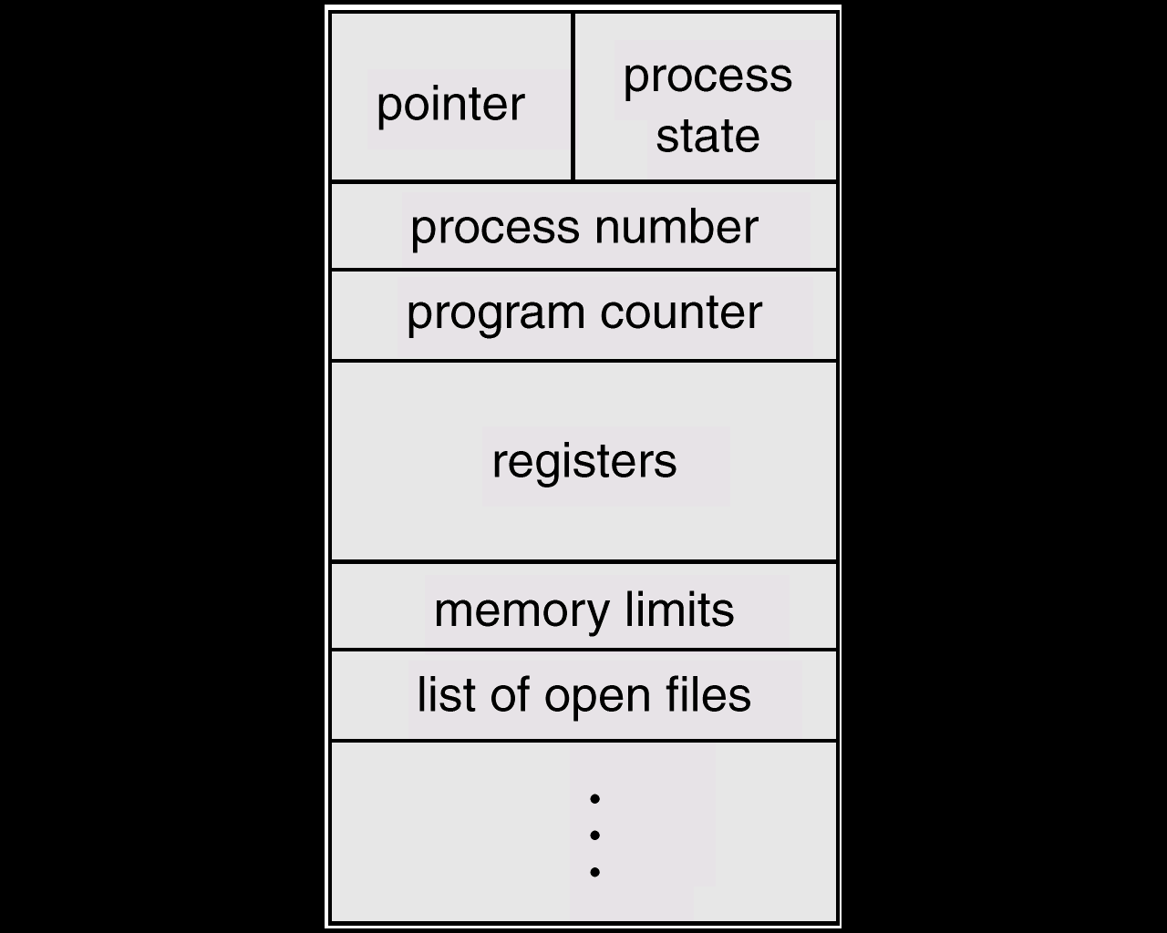
PROCESSES CONTROL BLOCK
PROCESS CONTROL BLOCK:
Contains information associated with each process
Is a data structure that holds:
PC, CPU registers
memory management information
accounting ( time used, ID, ... )
I/O status ( such as file resources )
scheduling data ( relative priority, etc. )
Process State (so running, suspended, etc)

Slide 6
PROCESSES CONTROL BLOCK
PCB is also called as task control block
Process state – running, waiting, etc.
Program counter – location of instruction to next execute
CPU registers – contents of all process-centric registers
CPU scheduling information- priorities, scheduling queue pointers
Memory-management information – memory allocated to the process
Accounting information–CPU used, clock time elapsed since start, time limits
I/O status information – I/O devices allocated to process, list of open files

Slide 7
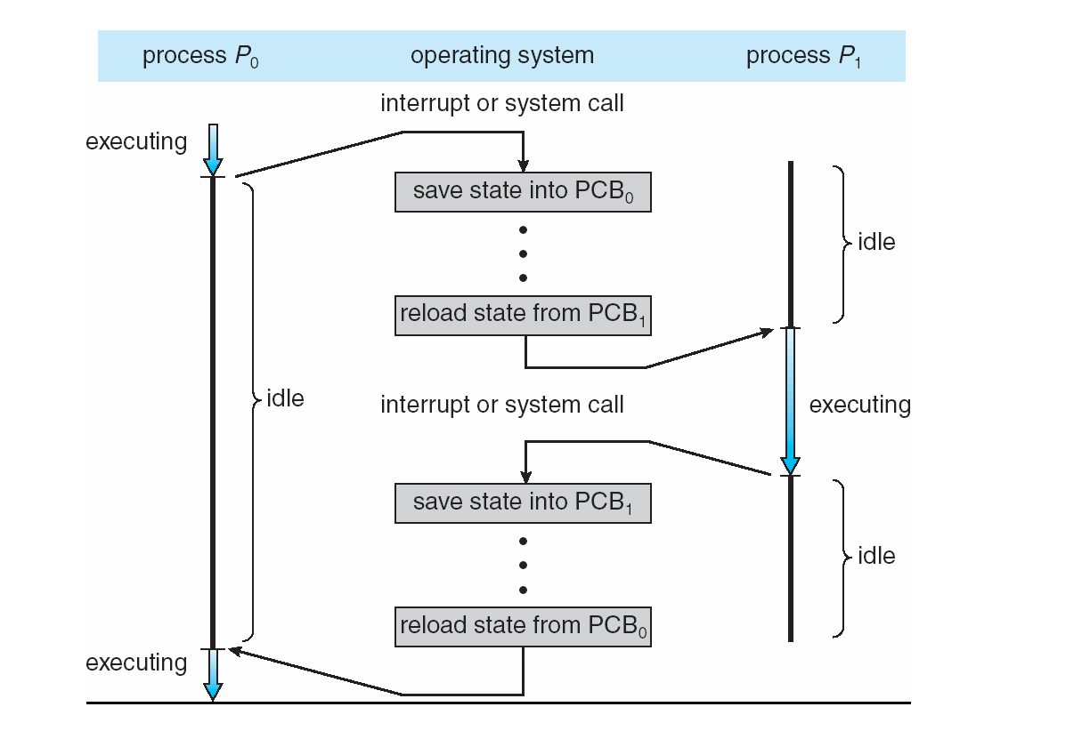
CPU Switch From Process to Process

Slide 8
Context Switching
When CPU switches to another process, the system must save the state of the old process and load the saved state for the new process via a context switch
Context of a process is represented in PCB
Context-switch time is overhead; the system does no useful work while switching
The more complex the OS & PCB -> longer the context switch
Time dependent on hardware support
Some hardware provides multiple sets of registers per CPU -> multiple contexts loaded at once

Slide 9
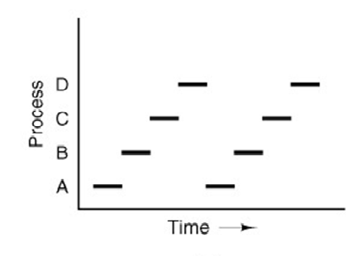
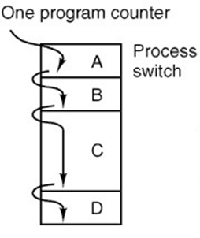
Context Switching
Fig. (a). Multiprogramming of four programs
Fig. (b). Process Model

Slide 10
Process Creation & Termination
Process Creation:
System initialization
Execution of process creation system call
User request to create process
Initialization of batch job
Process Termination:
Normal exit
Error exit
Fatal error
Killed by another process
SVT

Slide 11
Process States
New
Terminated
Admitted
Exit
Interrupt
Ready
Running
Scheduler Dispatch
I/O or Event Completion
I/O or Event Wait
Waiting
SVT

Slide 12
Threads

Slide 13
Processes and Threads
Processes are used to group resources
Threads are entities scheduled for execution
Traditional processes have two characteristics:
Resource Ownership
Scheduling/Execution
Process includes a virtual address space to hold the process image
the OS provides protection to prevent unwanted interference between processes with respect to resources
Follows an execution path that may be interleaved with other processes
a process has an execution state (Running, Ready, etc.) and a dispatching priority and is scheduled and dispatched by the OS
Traditional processes are sequential; i.e. only one execution path

Slide 14
Threads
Multithreading - The ability of an OS to support multiple, concurrent paths of execution within a single process
The unit of resource ownership is referred to as a process or task
The unit of dispatching is referred to as a thread or lightweight process
Each thread has :
an execution state (Running, Ready, etc.)
saved thread context when not running (TCB)
an execution stack
some per-thread static storage for local variables
access to the shared memory and resources of its process (all threads of a process share this)

Slide 15
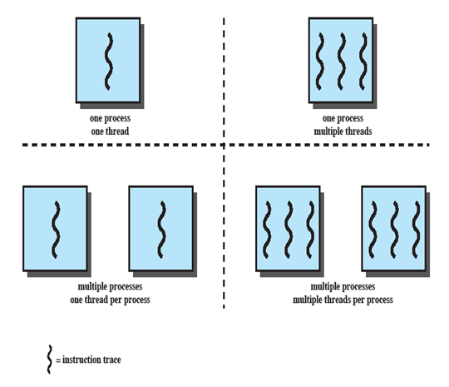
Single Threaded Approaches

Slide 16
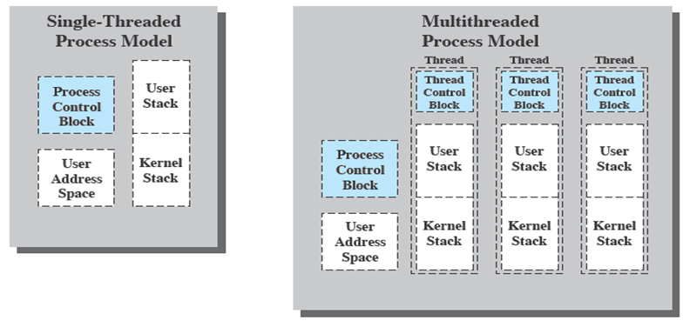
Threads

Slide 17
Benefits of Threads
Takes less time to create a new thread than a process
Less time to terminate a thread than a process
Switching between two threads takes less time than switching between processes
Threads enhance efficiency in communication between programs

Slide 18
Thread Execution States
The key states for a thread are:
Running
Ready
Blocked
Thread operations associated with a change in thread state are:
Spawn (create)
Block
Unblock
Finish

Slide 19
Processes & Threads
Per Process Items | Per Thread Item
Address Space Global Variables Open Files Child Processes Pending Alarms Signals & Signal Handlers Accounting Information | Program Counter Registers Stack State

Slide 20
Scheduling
SVT

Slide 21
Scheduling
Programs alternate between bursts of CPU and I/O
Burst Time is time required to complete execution of particular task
Program typically uses the CPU for some period of time, then does I/O, then again uses CPU again
Scheduling is decision about which job to give next burst of CPU (access)
Scheduler selects from among the processes in memory that are ready to execute, and allocates the CPU to one of them
SVT

Slide 22
When to Schedule?
CPU scheduling decisions may take place when
New process is created
Process switches from running to waiting state
Process switches from running to ready state
Process switches from waiting to ready state
Process terminates
SVT

Slide 23
Goals of Scheduling Algorithms
All Systems
Fairness – giving each process a fair share of CPU
Policy Enforcement – seeing that stated policy is carried out
Balance – keeping all parts of system busy
Batch Systems
Throughput – maximize jobs per hour
Turnaround Time – minimize time between submission & termination
CPU Utilization – keep the CPU busy all the time
Interactive Systems
Response Time – quick response
Proportionality – meet user’s expectation
Real Time Systems
Meet Deadlines – avoid losing data
Predictability – avoid quality degradation in multimedia systems
SVT

Slide 24
System Performance
Throughput:
Number of jobs completed per hour
Average waiting time:
Average time required by a process to get CPU bursts
Turnaround time:
Average time from the moment job is submitted until the moment job gets completed
Turnaround time = Waiting Time + Service Time
SVT

Slide 25
Scheduling Algorithms
FCFS- First Come First Serve SJF- Shortest Job First SRTF- Shortest Remaining Time First RR- Round Robin Priority Scheduling
SVT

Slide 26
First Come First Served
FCFS is same as FIFO queue
Processes get the CPU in the order they request it and run until they release it
Simple, fair, but poor performance
If first job has large CPU burst & next job has small burst time then it has to wait for longer time to let previous job get completed
Average queuing time is long
SVT

Slide 27
FCFS Example
Process Arrival Time Service Time 1 0 8
2 1 4
3 2 9
4 3 5
P1
P2
P3
P4
0
8
12
21
26
Residence Time
at CPU
Average Wait = ( [0]+[(8-1)] + (12-2) + [(21-3)] )/4 = 35/4 = 8.75
Turnaround Time=[(0+8)+(7+4)+(10+9)+(18+5)]/4=61/4=15.25
SVT

Slide 28
Shortest Job First
The CPU is assigned to the process that has the smallest next CPU burst
Bust time of the process must be known in prior
Optimal for minimizing queuing time, but impossible to implement.
Tries to predict the process to schedule based on previous history
SJF is a priority scheduling algorithm where priority is the predicted next CPU burst time
The disadvantage is that jobs with large CPU burst will never get CPU
SVT

Slide 29
SJF Example
Process Arrival Time Service Time
P₁ 0 6
P₂ 0 4
P₃ 0 1
P₄ 0 5
Average Wait = (0 + 1 + 5 + 10)/4 = 4
Turnaround Time=[(0+1)+(1+4)+(5+5)+(10+6)]/4=32/4=8
P₃
P₂
P₄
P₁
0
1
5
10
16
SVT

Slide 30
Pre-emptive SJF
Shortest Remaining Time First
Process Arrival Time Service Time
P₁ 0 7
P₂ 2 4
P₃ 4 1
P₄ 5 4
P₁
P₂
P₃
P₂
P₄
P₁
0
2
4
5
7
11
16
Average Waiting = ([0+(11-2)]+[(2-2)+(5-4)]+[0]+[(7-5)])/4=12/4=3
Turnaround Time=([0+(11-2)+7]+[(2-2)+(5-4)+4]+[0+1]+[(7-5)+4])/4=28/4=7
SVT

Slide 31
Priority Scheduling
A priority number is associated with each process
The CPU is allocated to the process with the highest priority (smallest integer → highest priority)
Priority scheduling can be either preemptive or non-preemptive
A preemptive approach will preempt the CPU if the priority of the newly-arrived process is higher than the priority of the currently running process
A non-preemptive approach will simply put the new process (with the highest priority) at the head of the ready queue
SVT

Slide 32
Priority Scheduling
The main problem with priority scheduling is starvation, that is, low priority processes may never execute
A solution is aging; as time progresses, the priority of a process in the ready queue is increased
SVT

Slide 33
Priority Scheduling Example
Non-Preemptive
Process Arrival Time Priority Service Time
1 0 2 5
2 2 4 2
3 4 0 3
4 5 1 4
P1
P3
P4
P2
0
5
8
12
14
Average Waiting=([0]+[(12-2)]+[(5-4)]+[(8-5)])/4=14/4=3.5
Turnaround Time=([0+5]+[(12-2)+2]+[(5-4)+4]+[(8-5)+4])/4=29/4=7.25
SVT

Slide 34
Priority Scheduling Example
Pre-emptive
Process Arrival Time Priority Service Time
1 0 2 5
2 2 4 2
3 4 0 3
4 5 1 4
P1
P3
P4
P1
P2
0
4
7
11
12
14
Average Waiting = ([0+(11-0)] +[ (12-2)] +[0]+[(7-5)])/4 = 23/4 = 5.75
Turnaround Time=([0+(11-0)+5] +[ (12-2)+2] +[0+3]+[(7-5)+4])/4=37/4=9.25
SVT

Slide 35
Round Robin (RR) Scheduling
In the round robin algorithm, each process gets a small unit of CPU time called as quantum, usually 10-100 milliseconds
After this time has elapsed, the process is pre-empted and added to the end of the ready queue
If there are n processes in the ready queue and the time quantum is q, then each process gets 1/n of the CPU time in chunks of at most q time units at once
No process waits more than (n-1)q time units
SVT

Slide 36
Round Robin Scheduling Example
Performance of the round robin algorithm
q large → reschedule latency is large. If many processes want the CPU, then each process has to wait for long time before it can get the CPU
q small → q must be greater than the context switch time; otherwise, the overhead is too high
SVT

Slide 37
Round Robin Scheduling Example
Process Arrival Service
Time Time
1 0 8
2 1 4
3 2 9
4 3 5
Quantum = 4
P1
P2
P3
P4
P1
P3
P4
P3
0
4
8
12
16
20
24
25
26
Average Waiting=([0+(16-4) ]+[(4-1)]+[(8-2)+(20-12)+(25-24)]+[(12-3)+(24-16)])/4 =47/4 =11.75
Turnaround Time=([0+(16-4)+8]+[(4-1)+4]+[(8-2)+(20-12)+(25-24)+9]+[(12- 3)+(24-16)+5])/4=103/4=25.75
SVT

Slide 38
Comparison
Scheduling Algorithms | CPU Overhead | Throughput | Turnaround time | Response Time
First Come First Serve | Low | Low | High | Low
Shortest Job First | Medium | High | Medium | Medium
Priority Based | Medium | Low | High | High
Round Robin | High | Medium | Medium | High
SVT

Slide 39
Thank You!

